Slide 1

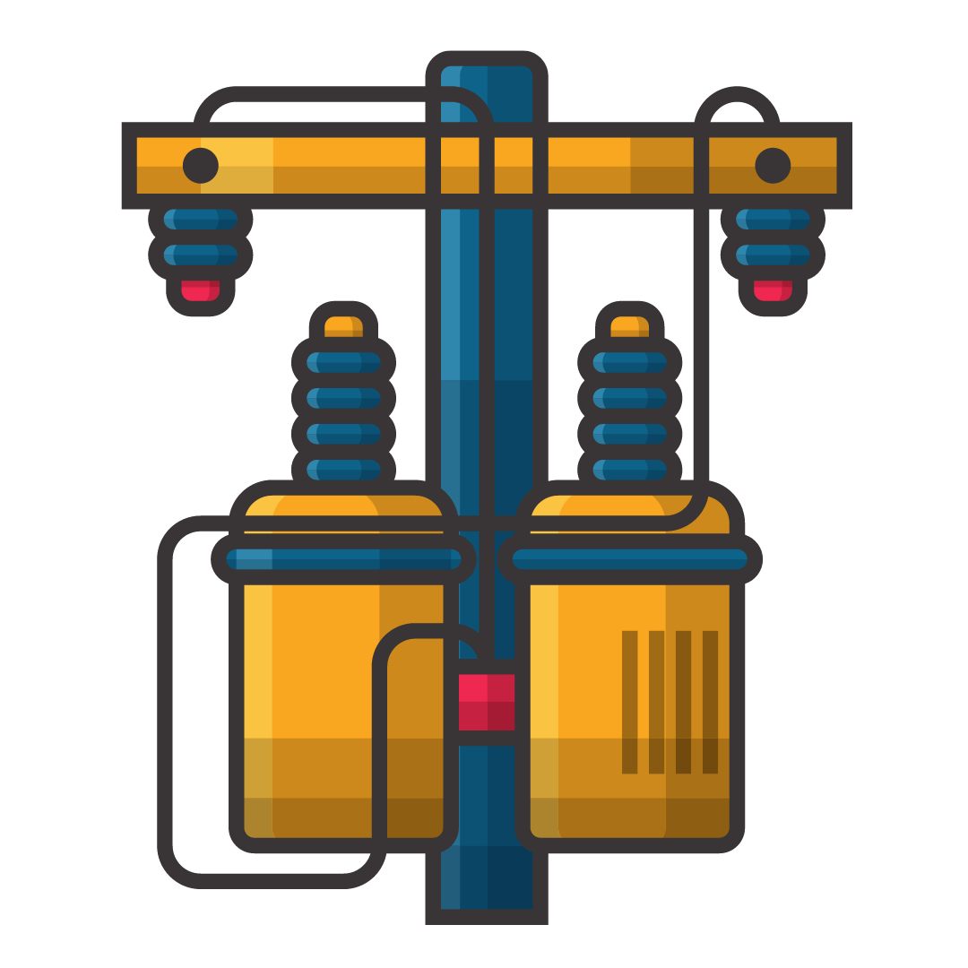
TRANSFORMERS
AND THEIR APPLICATIONS
By-
Parth Johri (2K20/B17/33)
Tushar Aggarwal (2K20/B17/48)
UNDER SUPERVISION OF-
Dr. Rajesh Kumar
(Assistant Prof.)

Slide 2
INTRODUCTION
In most cases, appliances are manufactured to work under some specific voltages.
Transformers are used to adjust the voltages to a proper level.
The transformers are the basic components for the transmission of the electricity.
Transformer is used to increase the voltage at the power generating station (Step up) and used to decrease the voltage(Step down) for household purpose.
By increasing the voltages the loss of the electricity in the transmission purpose is minimized.

Slide 3

CONSTRUCTION
Laminated Core
Cores are designed not to have current in it still there is a leakages current or the eddy current present in it to minimize these current the cores are laminated
Winding
It is made up of copper or aluminum coated with very thin layer of insulation.
Tank
The main function of conservator tank of transformer is to provide adequate space for expansion of oil inside the transformer ,it is usually cylindrical or cubical.
Isolation
It is provided by using Synthetic Oil between Core and Tank.
Breather
When the temperature changes occur in transformer insulating oil, the oil expands or contracts and there an exchange of air also occurs when transformer is fully loaded.
When transformer gets cooled, the oil level goes down and air gets absorbed within

Slide 4
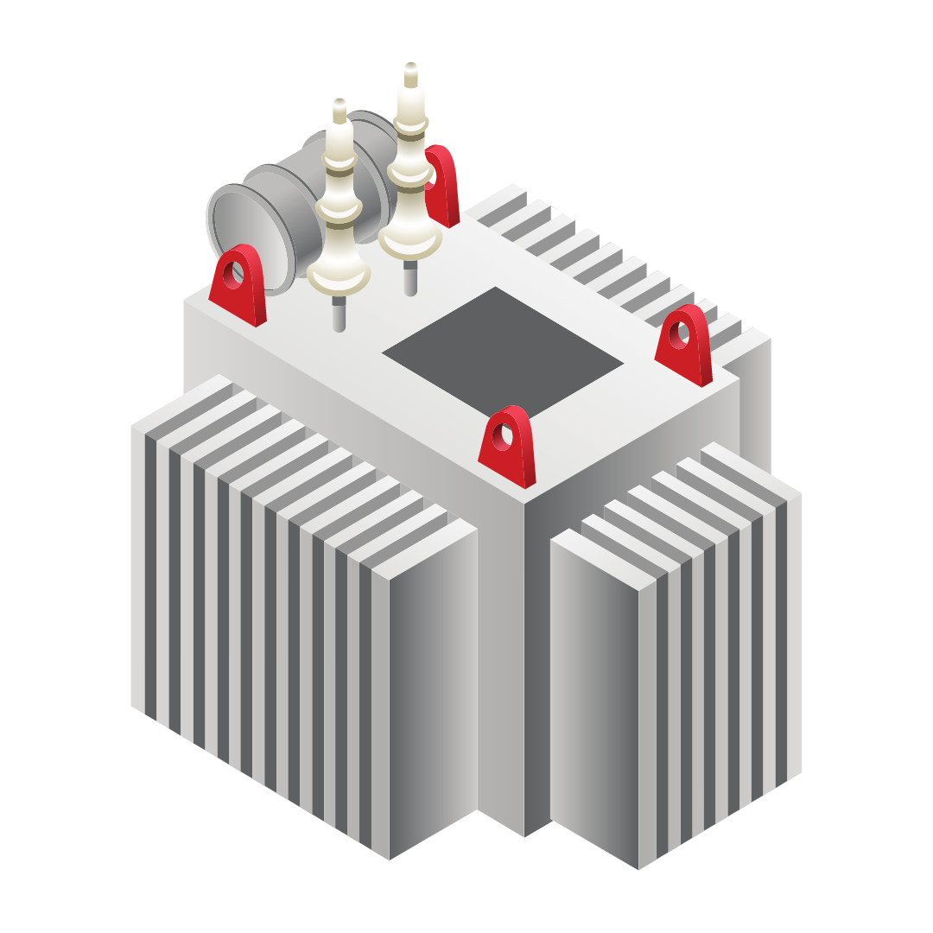
WORKING
PRINCIPLE
The main principle of operation of a transformer is Mutual Inductance between two circuits which is linked by a common magnetic flux. A basic transformer consists of two coils that are electrically separate and inductive, but are magnetically linked through a path of reluctance.
When the alternating current flows in the primary coils, a changing magnetic flux is generated around the primary coil. The changing magnetic flux is transferred to the secondary coil through the iron core.
The changing magnetic flux is cut by the secondary coil, hence induces an Electromotive force (EMF)
in the secondary coil.

Slide 5
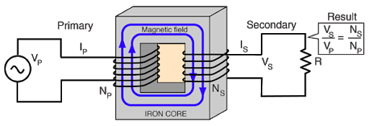
Now if load is connected to a secondary winding, this EMF drives a current through it The magnitude of the output voltage can be controlled by the ratio of the no. of primary coil and secondary coil.
The frequency of mutually induced EMF is same as that of the alternating source which is supplying to the primary winding.

Slide 6
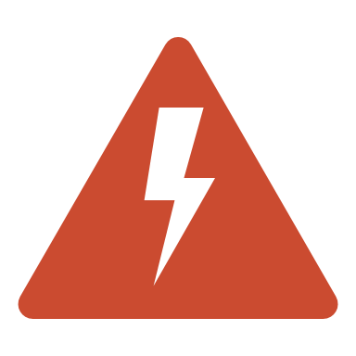


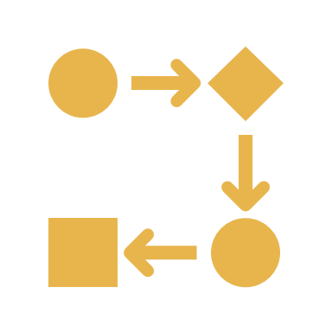
KEY PROPERTIES
A transformer is a static device.
The word ‘transformer’ comes form the word ‘transform’.
Transformer is not an energy conversion device, but it is device that changes AC electrical power at one voltage level into AC electrical power at another voltage level through the action of magnetic field but with a proportional increase or decrease in the current ratings., without a change in frequency.
It can be either to step-up or step-down.

Slide 7


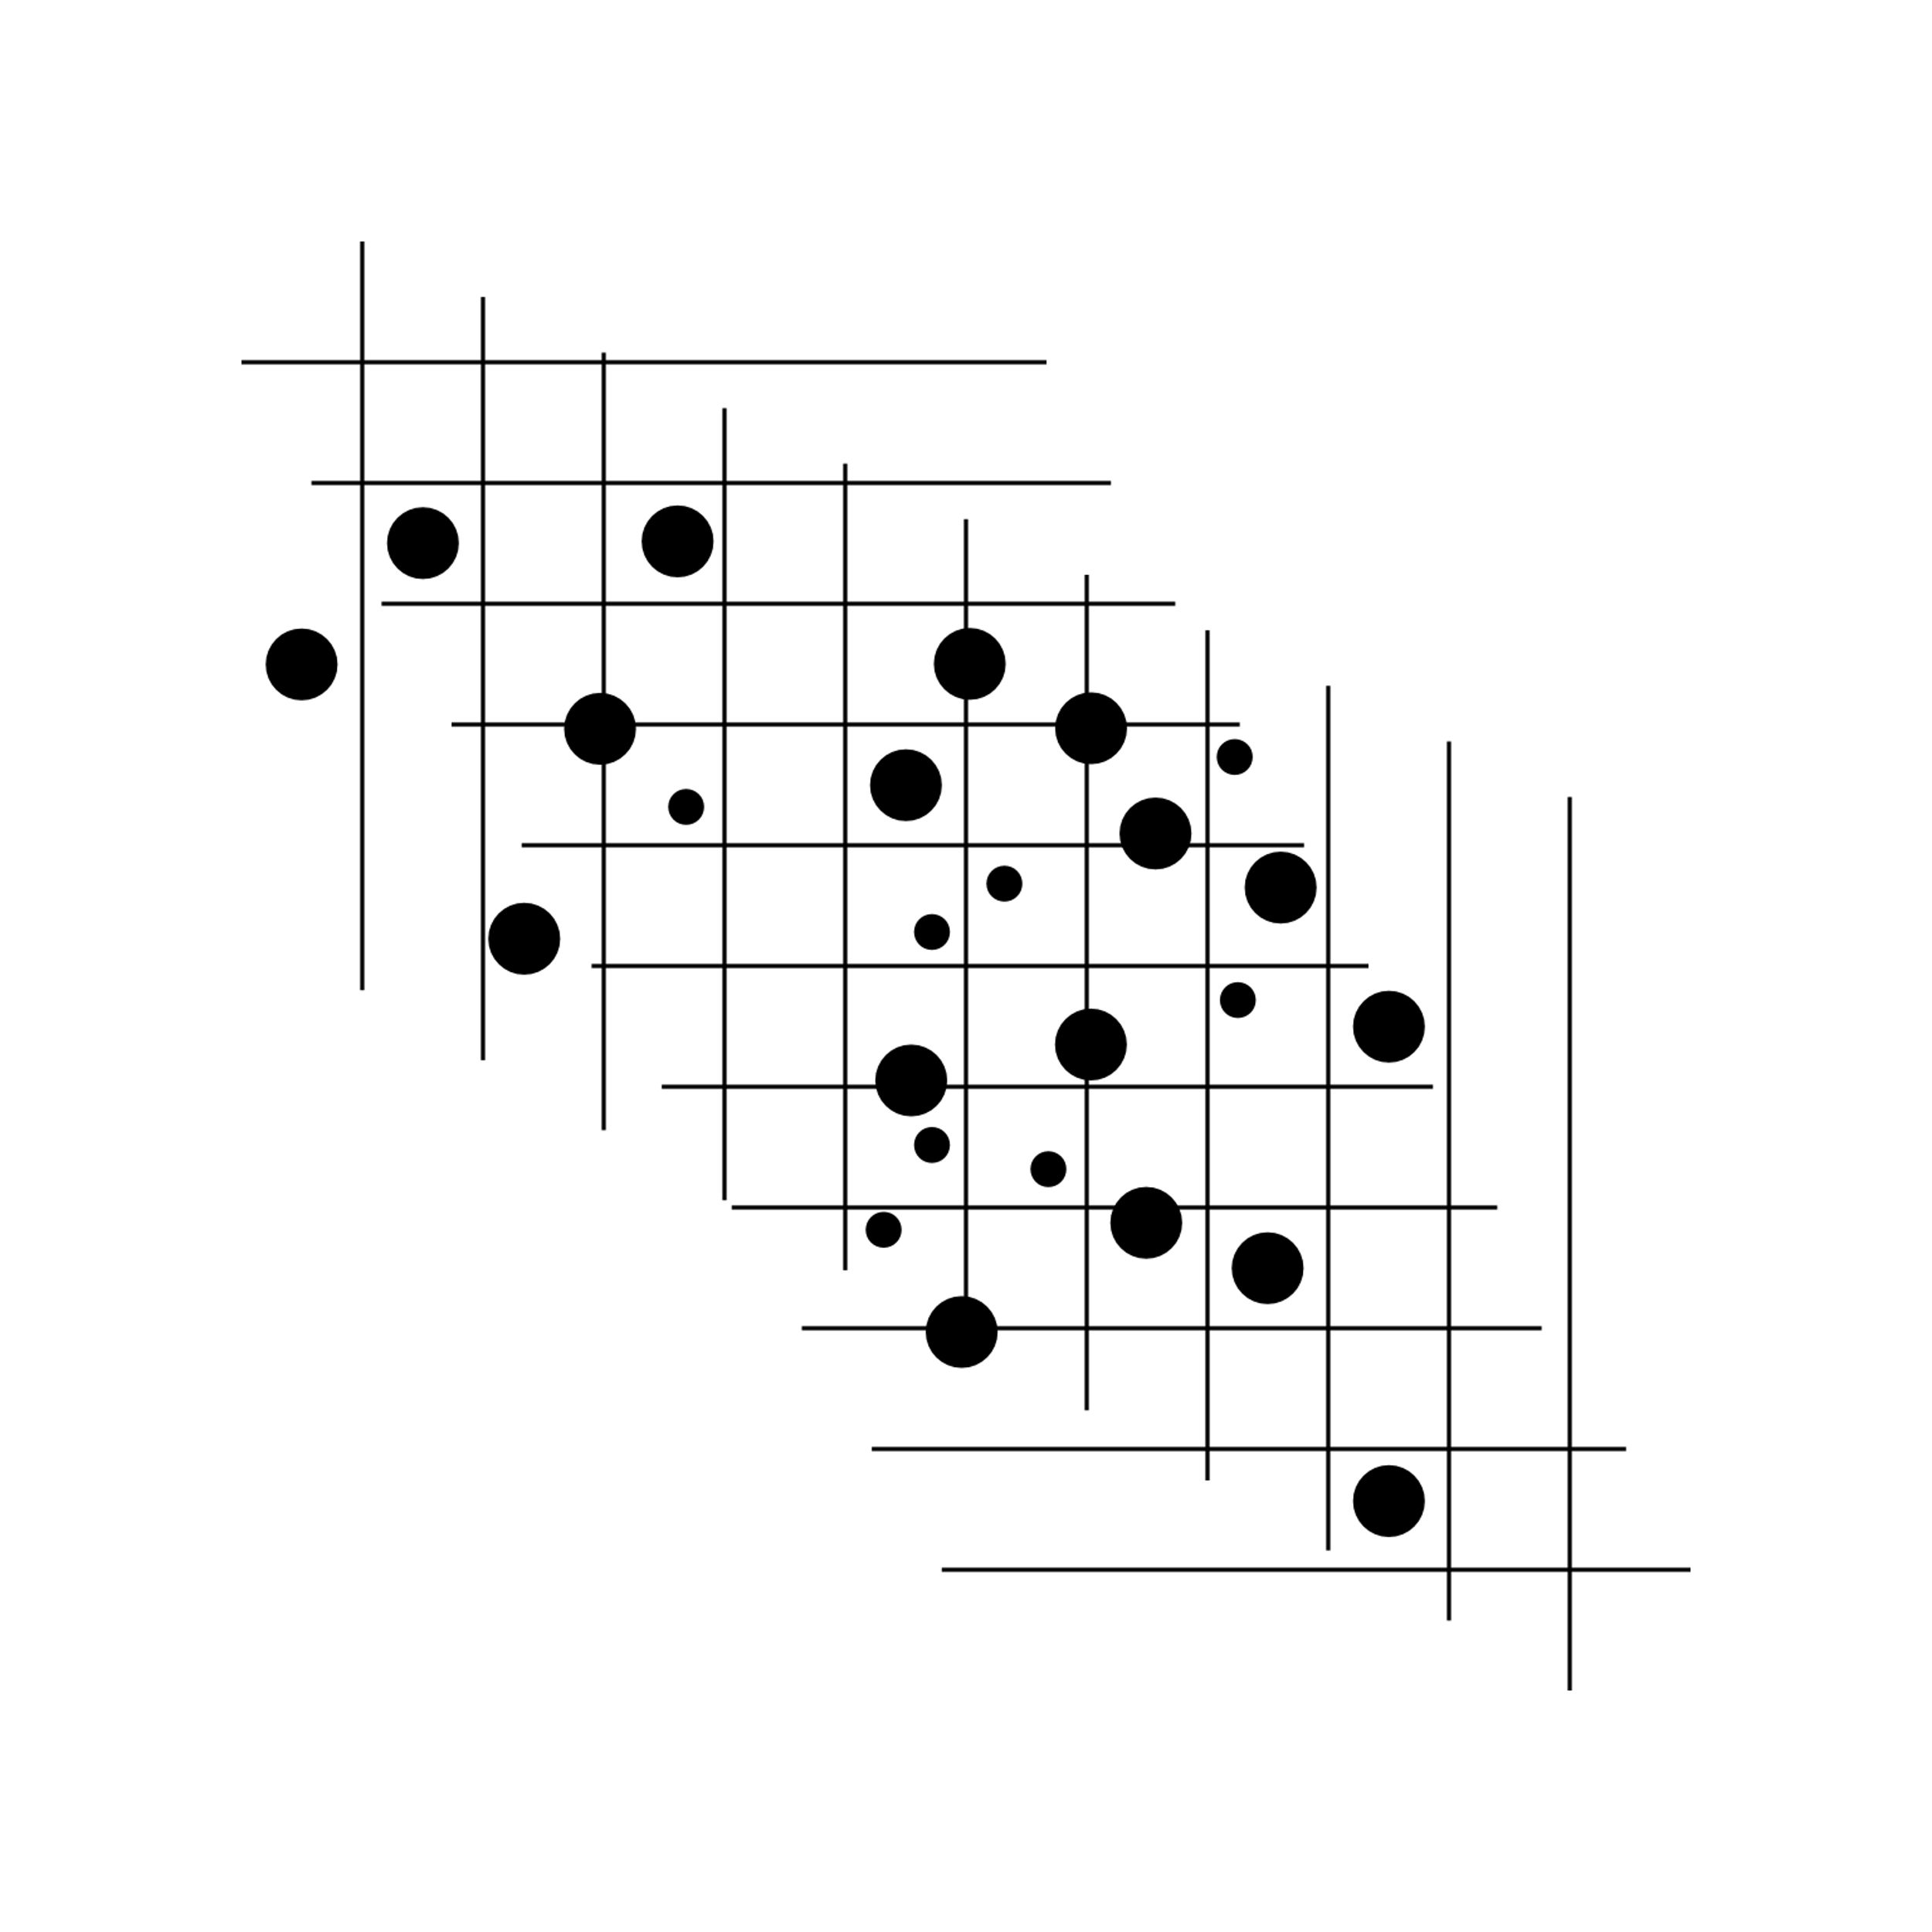
STRUCTURE OF TRANSFORMER
The transformer has two inductive coils ,these are electrical separated but linked through a common magnetic current circuit.
These two coils have a high mutual induction.
One of the two coils is connected of alternating voltage .
This coil in which electrical energy is fed with the help of source called primary winding. The other winding is connected to a load the electrical energy is transformed to this winding drawn out to the load .
This winding is called secondary winding.
The primary and secondary coil are wound on a ferromagnetic metal core.
The function of the core is to transfer the changing magnetic flux from the primary coil to the secondary coil .
The primary has N1 no of turns and the secondary has N2 no of turns the of turns plays major important role in the function of transformer.

Slide 8

BASIC TYPES OF TRANSFORMERS
STEP UP TRANSFORMER:
The no of windings on Primary side is less than the no. of windings on the Secondary side i.e. Np < Ns.
STEP DOWN TRANSFORMER:
The no. of winding on Primary side are more than the no. of windings on the Secondary side i.e. Np > Ns.
ISOLATION TRANSFORMER:
The no. of winding on Primary side are equal to the no. of windings on the secondary side i.e Np = Ns

Slide 9
BASIS OF COOLANT
Oil filled self cooling:
Oil filled self cooled type uses small and medium-sized distribution transformers. The assembled windings and core of such transformers are mounted in a welded, oil-tight steel tanks provided with a steel cover…
The oil helps in transferring the heat from the core and the windings to the case from where it is radiated out to the surroundings.
Oil filled water cooled:
This type is used for much more economic construction of large transformers. The cooling coil is mounted near the surface of the oil, through which cold water keeps circulating. This water carries the heat from the device.
Air Blast:
This type is used for transformers that use voltages below 25,000 volts.
and is used at houses

Slide 10

Applications
1. Transmitting electrical energy over long distances through wires,permitting transmission of huge amounts of power along long distances to appropriate distribution points at tremendous saving in the cost of the transmission line as well as in power loss.
2. Transformers with several secondary's are used in television and radio receivers where several different voltages are required.
3. Used as voltage regulator
4. In radio and television circuit input transformers, interstage transformers and output transformers are widely used.
5. Transformers are also used in telephone circuit, instrumentations circuit and control circuit.

Slide 11
THANK
YOU
:)

